Slide 1

DIABETES DISEASE PREDICTION USING ENSEMBLE MACHINE LEARNING
AURORA’S PG COLLEGE(MCA)
SUBMITTED BY: GUIDED BY:
NAME: M K N REVANTH KUMAR Mrs. S. VIJAYA LAKSHMI
HT NO: 2129-24-826-081

Slide 2
ABSTRACT
This project is about predicting the diabetes of the patient using the data.
Using the past records of the patents data using the ensemble machine learning techniques
like random forest and decision tree models we will be predicting the diabetes of the patient bases on the features taken from the data.
Ensemble techniques will take more than one algorithm in an algorithm to predict the output.
Based on the independent features of the patient health condition the machine learning model will be predicting whether the patient has diabetes or not.
Using frontend techniques, we will be sending the predicted data we will be creating the webpage, and we will be
showing the statistics of the patient's diabetes predicted data.

Slide 3
INTRODUCTION
Diabetes Disease Prediction using Ensemble Machine Learning techniques.
This Project is about predicting the diabetes disease of a person using machine learning ensemble techniques or algorithms.
Using various algorithms available in ensemble algorithms we
should predict whether the person is having diabetes or not.
Ensemble techniques uses supervised or unsupervised techniques,
To get trained using the dataset to predict the output.
System Analysis
Existing System.
Proposed System.

Slide 4
EXISTING SYSTEM
The existing system primarily relies on manual diagnosis and traditional clinical methods.
Patients must visit a healthcare facility to undergo physical tests, such as fasting blood Glucose, or oral glucose tolerance tests.
Disadvantages
Manual Dependency: Diagnosis depends heavily on the physical presence of the patient and the availability of medical experts.
Time-Consuming: Laboratory results often take hours or days to be processed and communicated back to the patient.
Late Detection: Because symptoms can be subtle in the early stages, manual systems often fail to identify "prediabetic“
conditions until the disease has progressed.
Costly: Frequent visits to diagnostic centers and specialized laboratory tests increase the financial burden on the patient.

Slide 5
PROPOSED SYSTEM
The proposed system introduces an automated, machine learning-driven approach to predict diabetes using historical data.
By utilizing ensemble techniques, the system
provides a more robust and accurate output compared to single-model approaches.
Ensemble Modeling: The system uses Random Forest and Decision Tree models. By
combining multiple algorithms, it minimizes errors and provides a more reliable prediction of whether a patient is diabetic.
Advantages
Feature-Based Prediction: The model analyzes independent patient health features (such as BMI, glucose levels, and age) to determine the output. Web-Based
Interface: Unlike traditional methods, this system features a frontend webpage. Users can input data digitally and receive results instantly.
Data Visualization: The proposed system doesn't just give a "Yes/No" result; it displays statistics of the predicted data, allowing for a better understanding of the patient's health trends.
Efficiency: It reduces the need for constant clinical visits for preliminary risk assessment, saving both time and money for the patient and the healthcare provider.

Slide 6
SYSTEM REQUIREMENTS
HARDWARE REQUIREMENTS
MINIMUM (Required for Execution) |  | MY SYSTEM (Development)
System | Pentium IV 2.2 GHz | i5 Processor 5th Gen
Hard Disk | 50GB | 512 Gb
Ram | 4 Gb | 8 Gb
SOFTWARE REQUIREMENTS
Operating System | Windows 10/11
Development Software | Machine Learning.
Programming Language | Python/Java.
Database | MYSQL.
Frontend Development | HTML, CSS, and JavaScript.
Web Server | Flask.

Slide 7
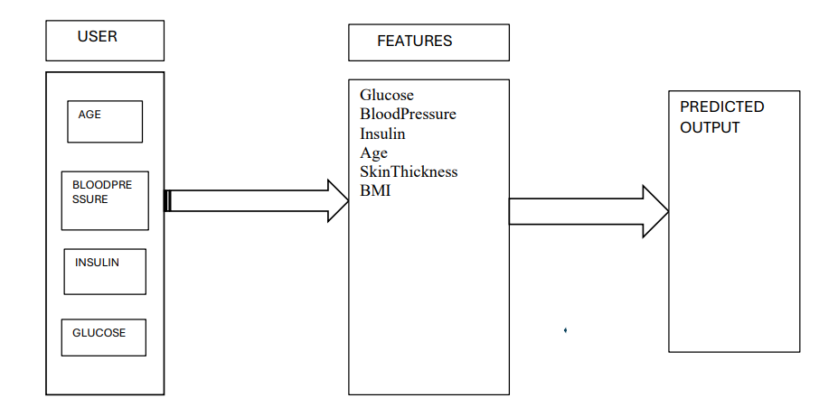
ER DIAGRAM

Slide 8
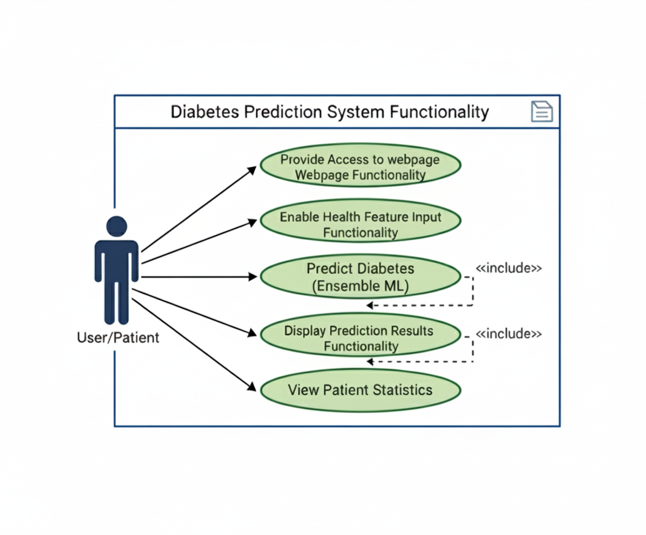
UML DIAGRAMS
USE CASE DIAGRAM

Slide 9
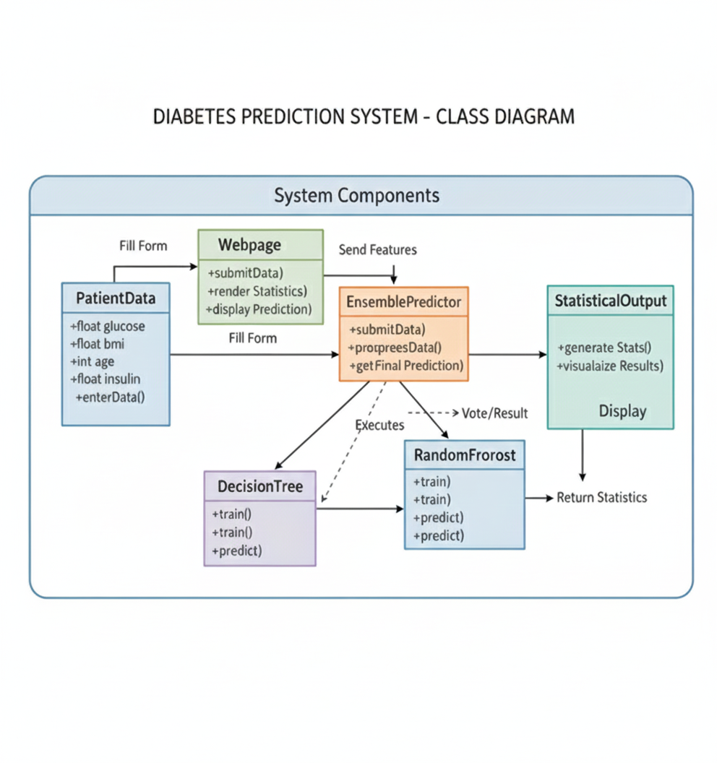
UML DIAGRAMS
CLASS DIAGRAM

Slide 10
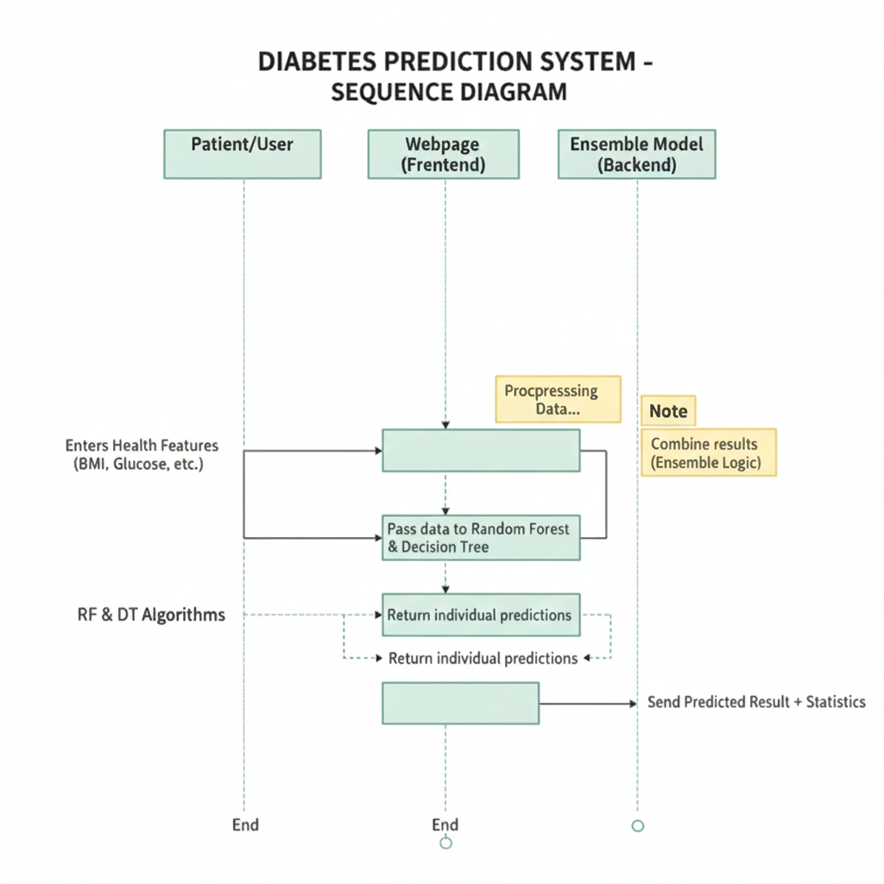
UML DIAGRAMS
SEQUENCE DIAGRAM

Slide 11
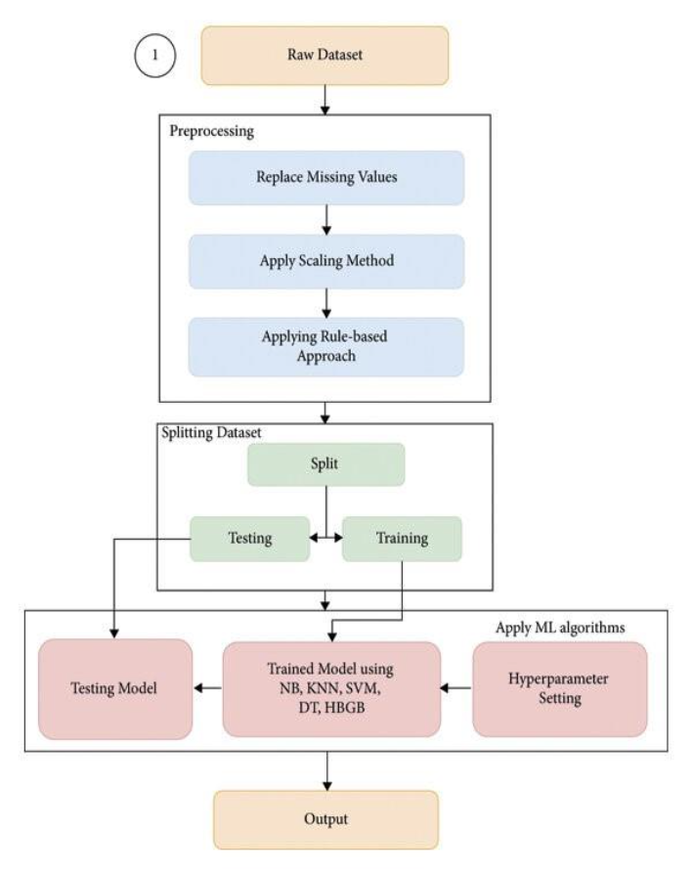
UML DIAGRAMS
COLLABORATION DIAGRAM

Slide 12
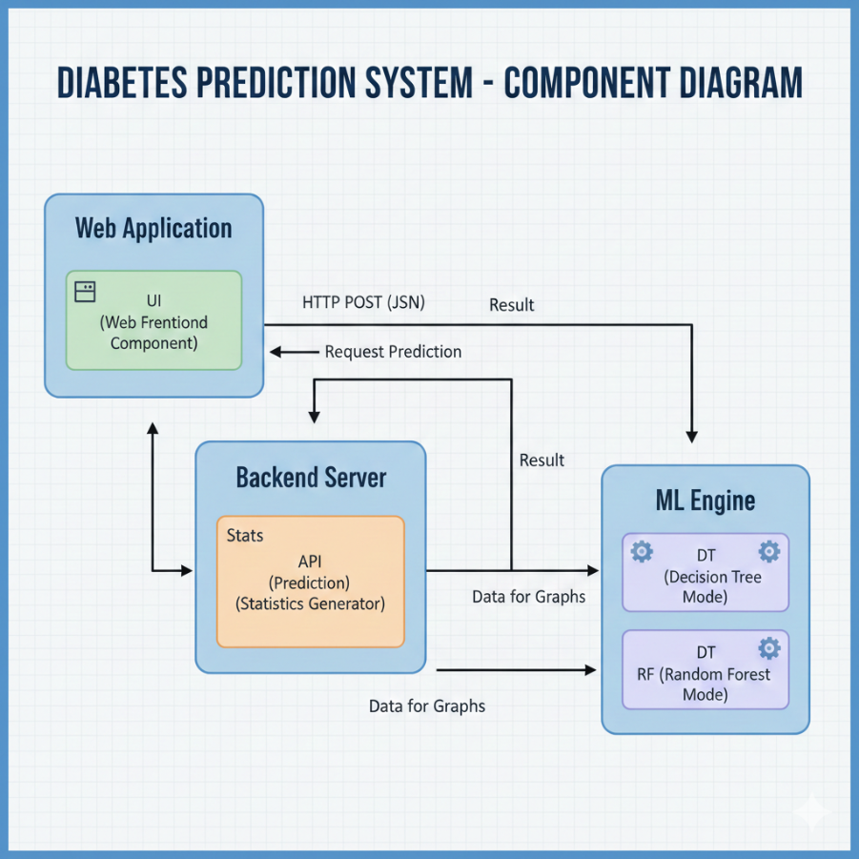
UML DIAGRAMS
COMPONENT DIAGRAM

Slide 13
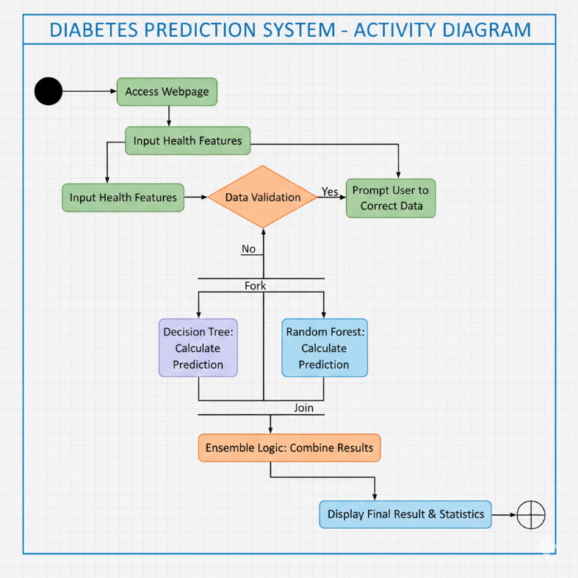
UML DIAGRAMS
ACTIVITY DIAGRAM

Slide 14
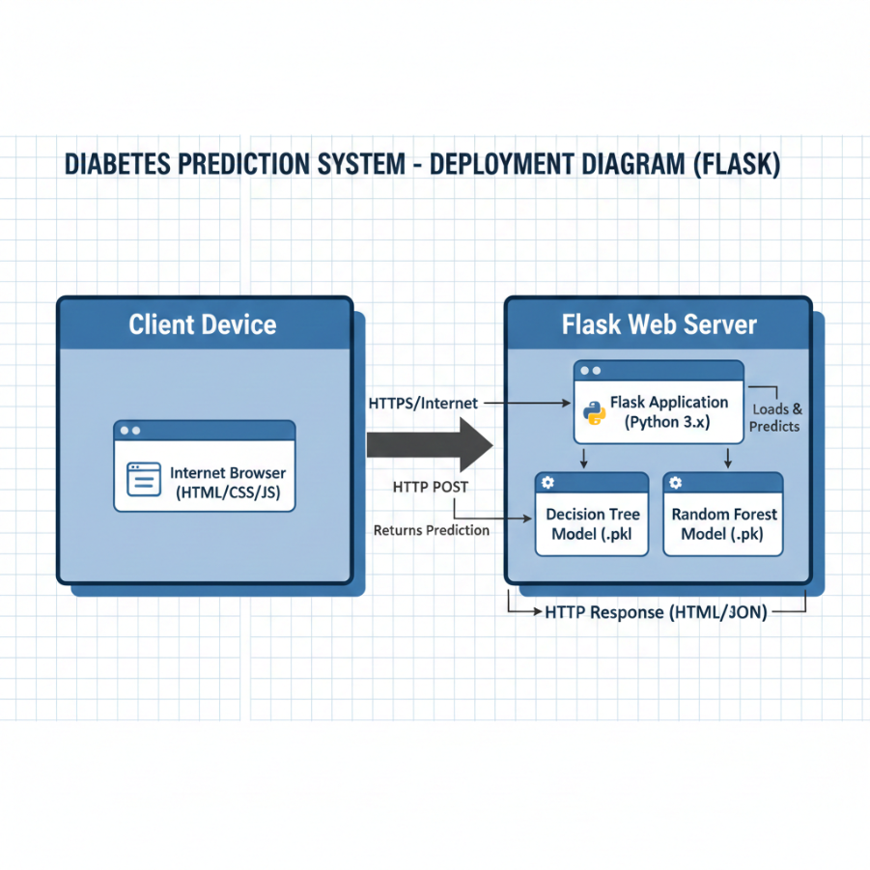
UML DIAGRAMS
DEYPLOYMENT DIAGRAM

Slide 15
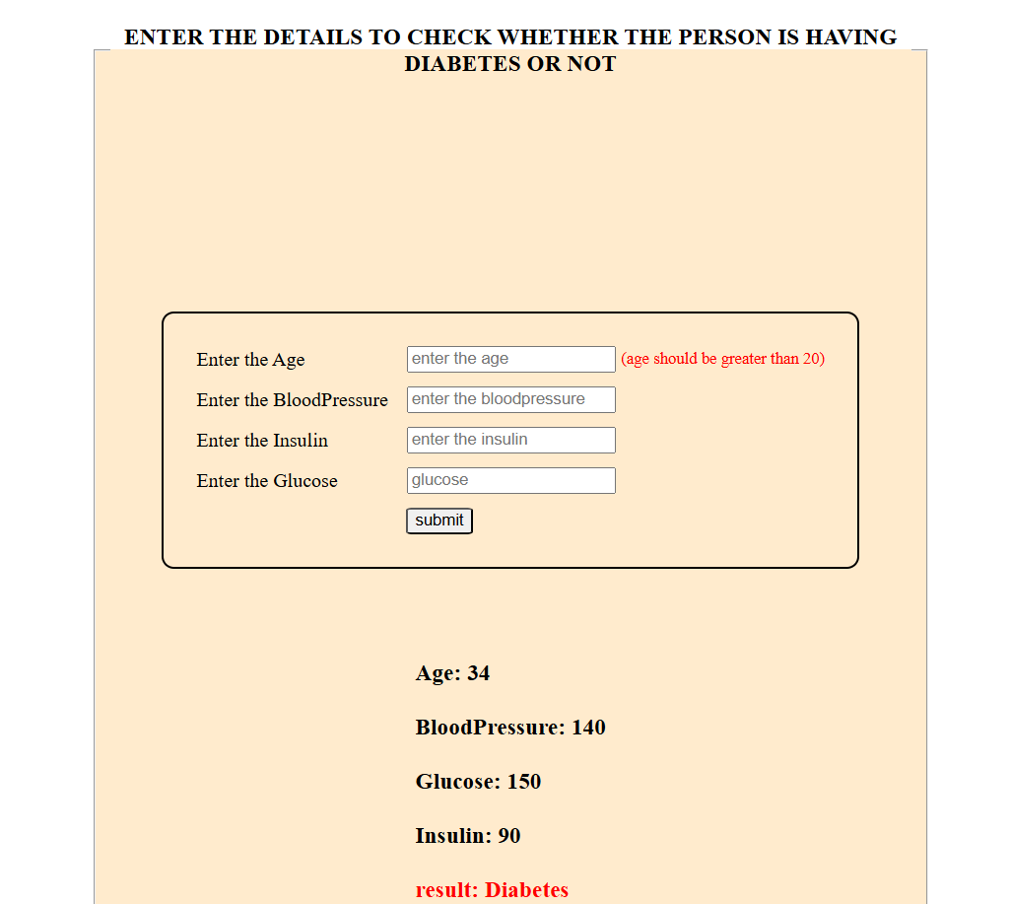
WEB APPLICATION FOR DIABETES DISEASE PREDICTION

Slide 16
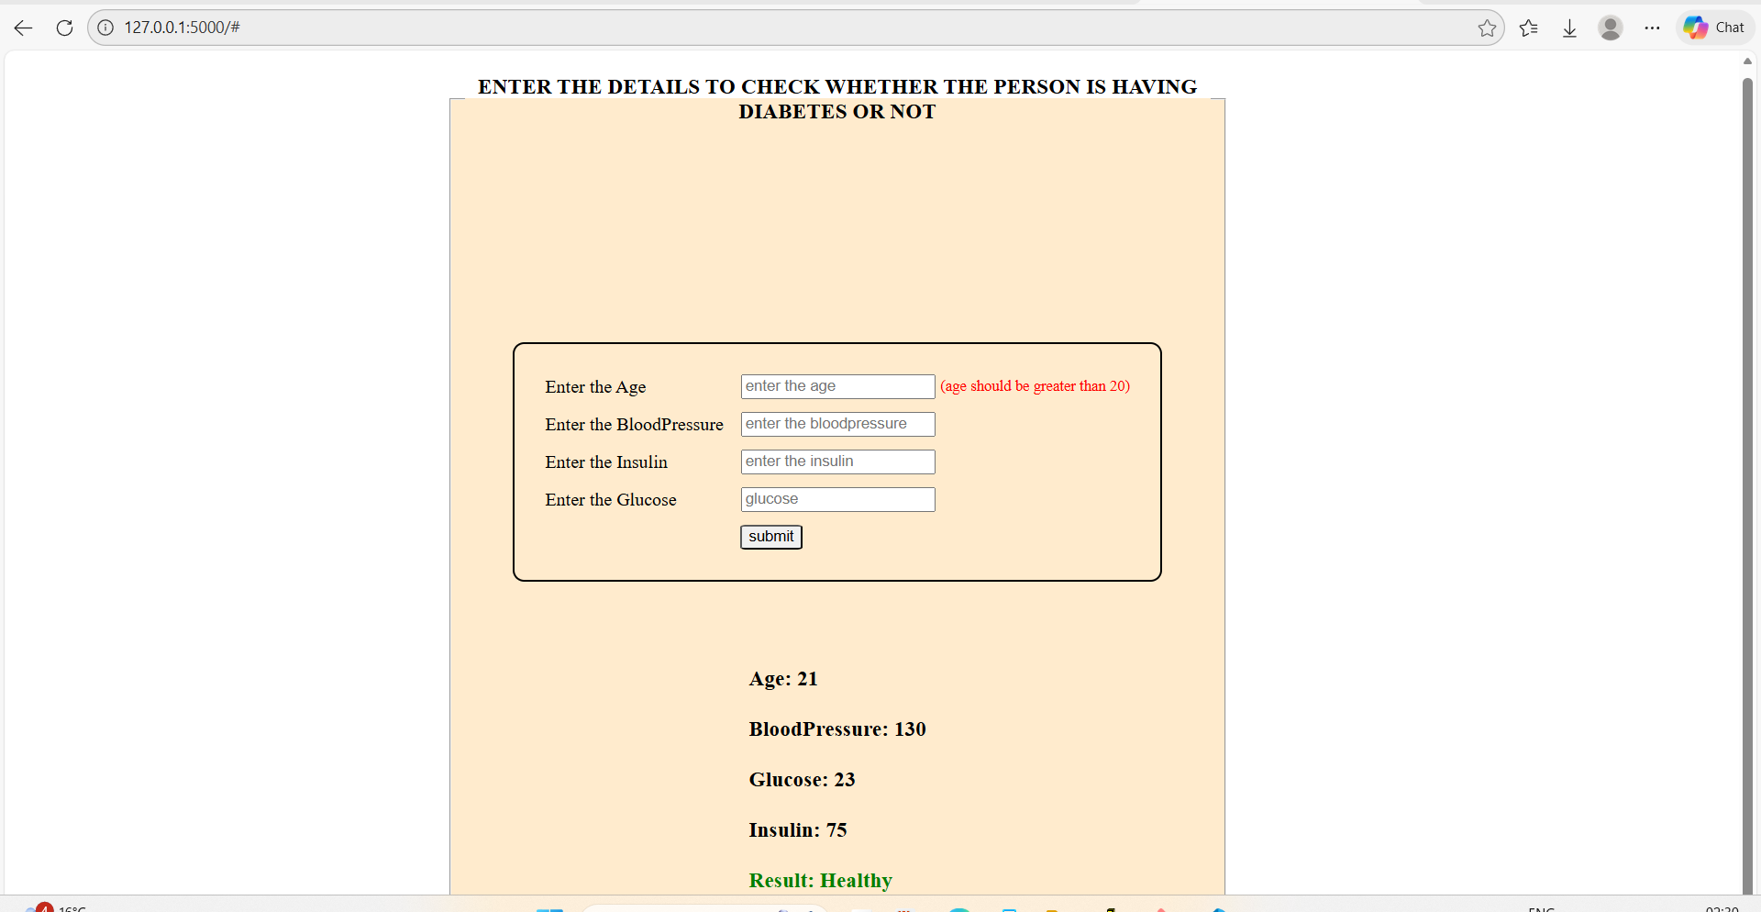
WEB APPLICATION FOR DIABETES DISEASE PREDICTION

Slide 17
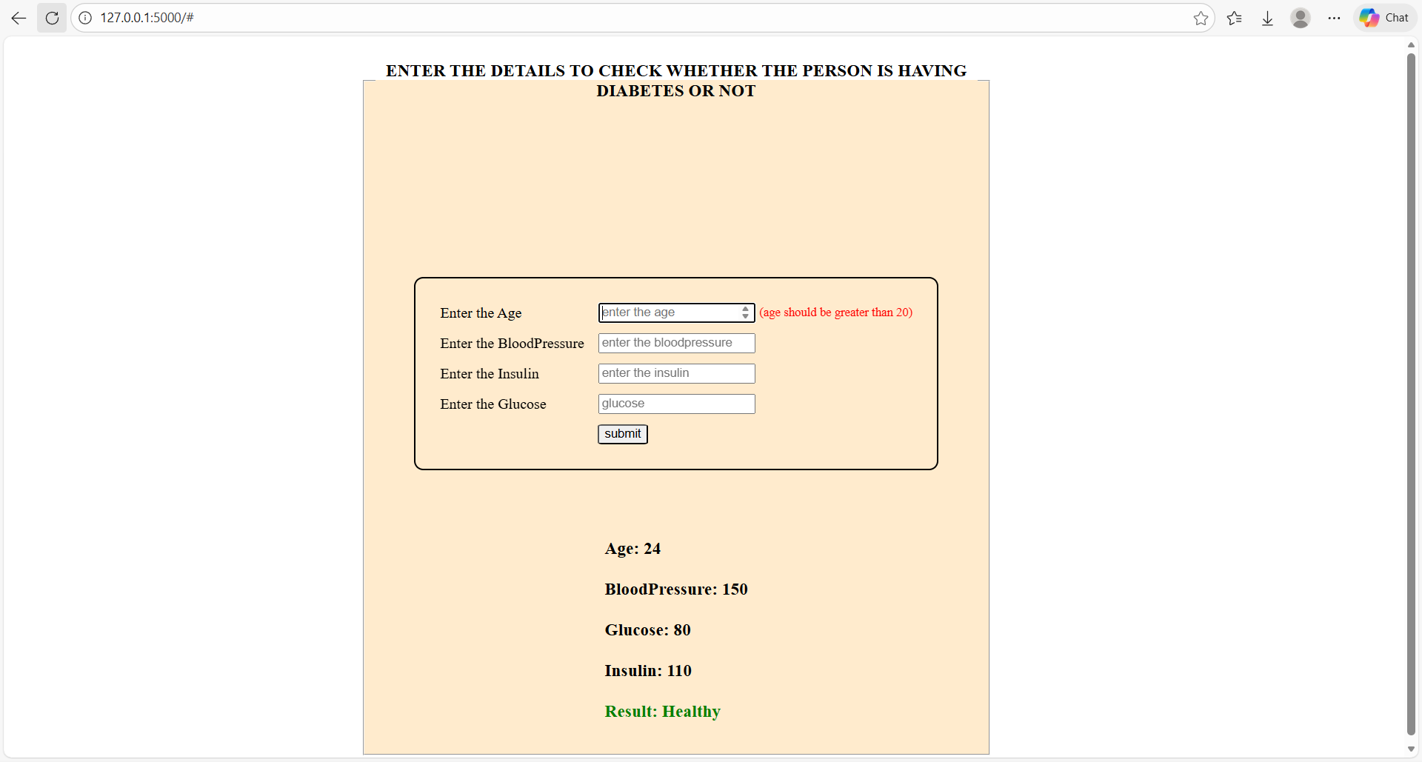
WEB APPLICATION FOR DIABETES DISEASE PREDICTION

Slide 18
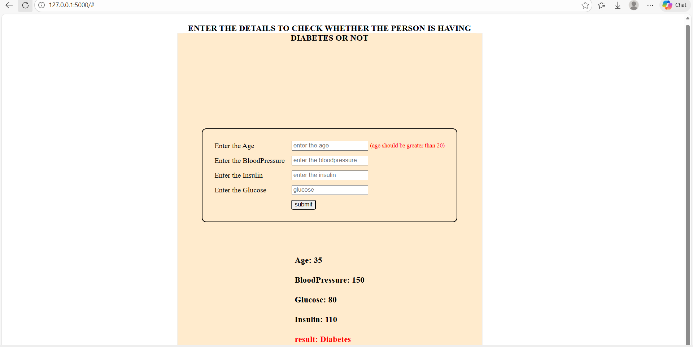
WEB APPLICATION FOR DIABETES DISEASE PREDICTION

Slide 19
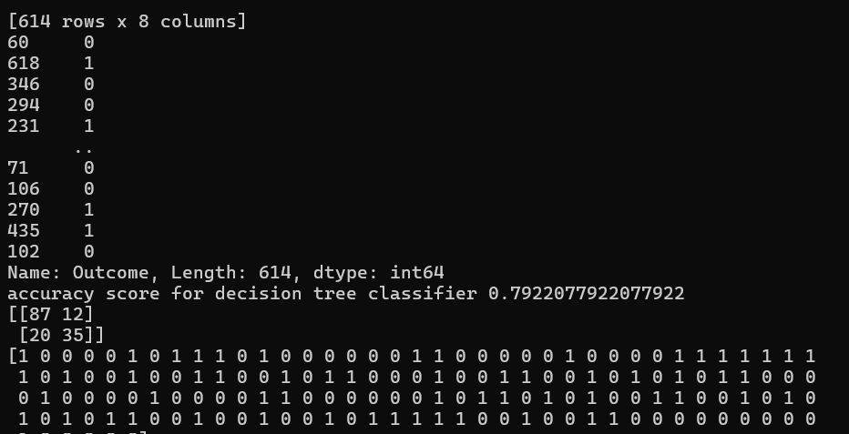
DECISION TREE CLASSIFIER OUTPUT

Slide 20
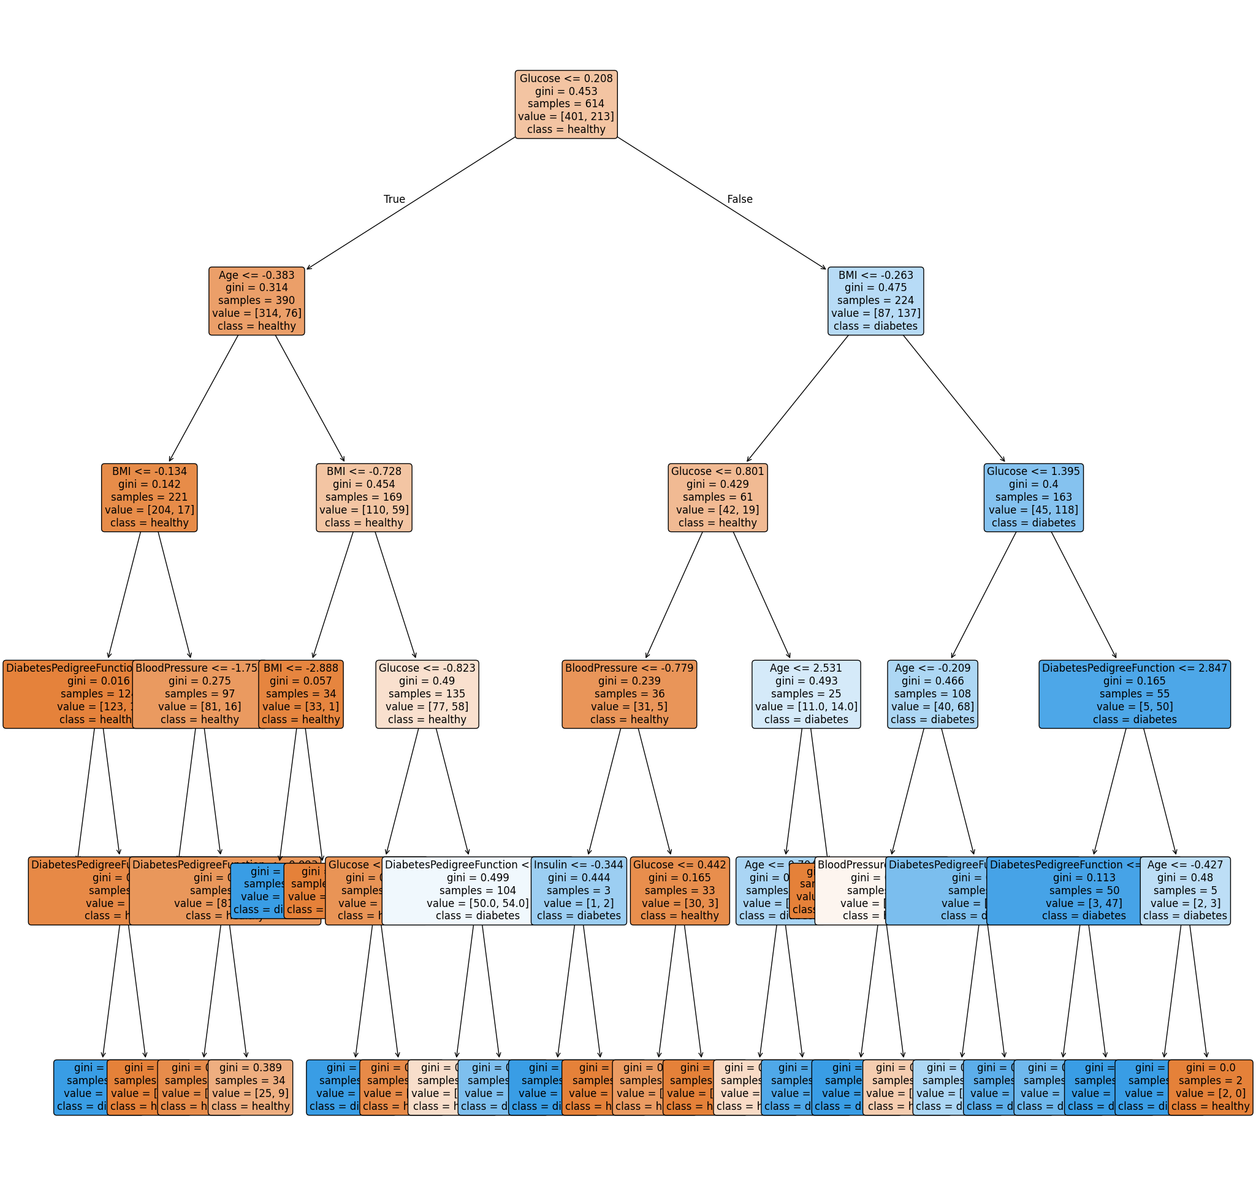
DECISION TREE CLASSIFIER ANALYSIS

Slide 21
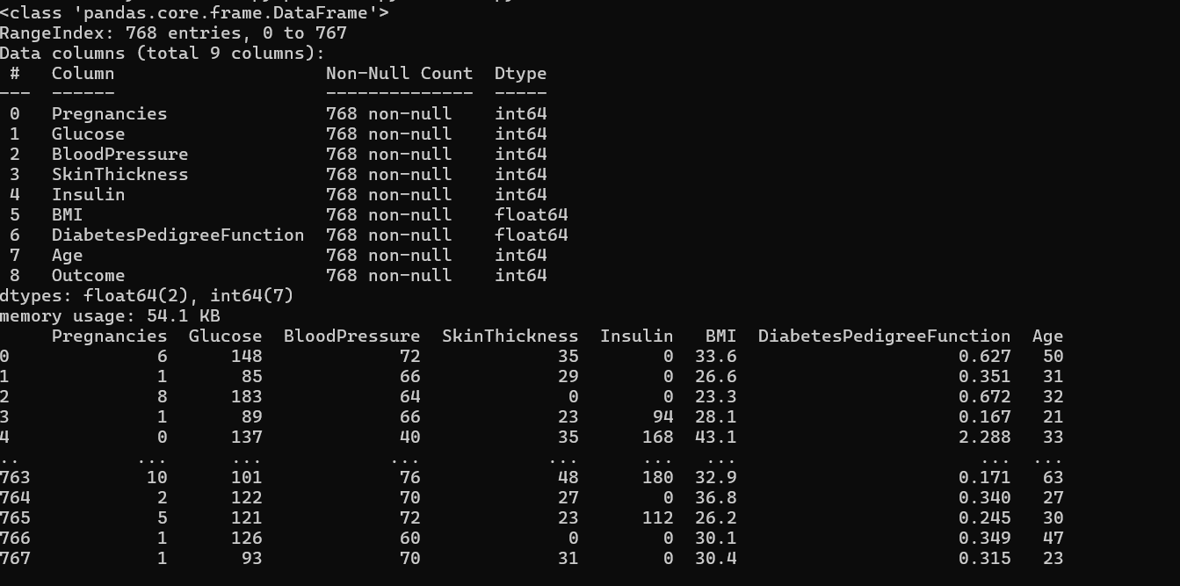
DECISION TREE CLASSIFIER CONFUSION MATRIX

Slide 22
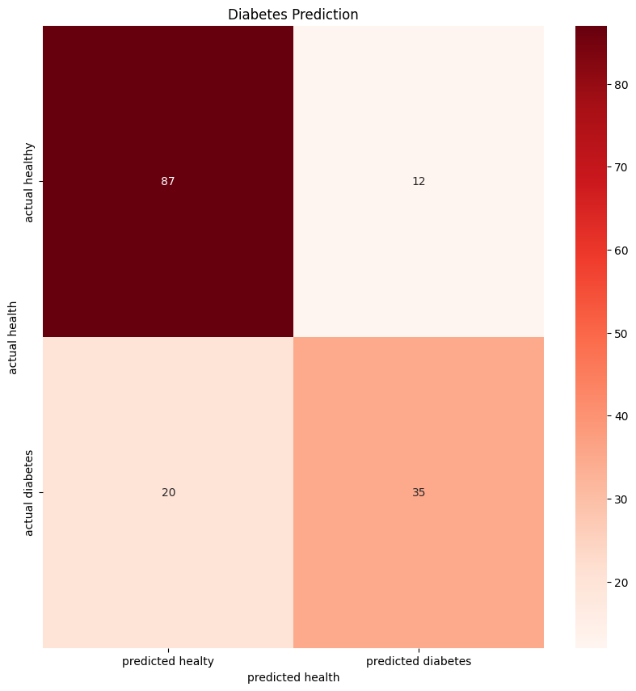
DECISION TREE CLASSIFIER CONFUSION MATRIX

Slide 23
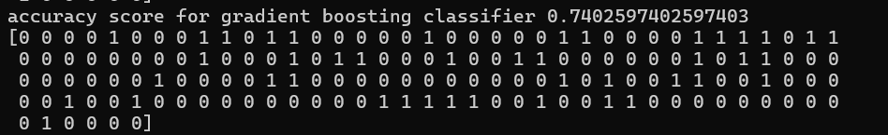
GRADIENT BOOSTING CLASSIFIER

Slide 24
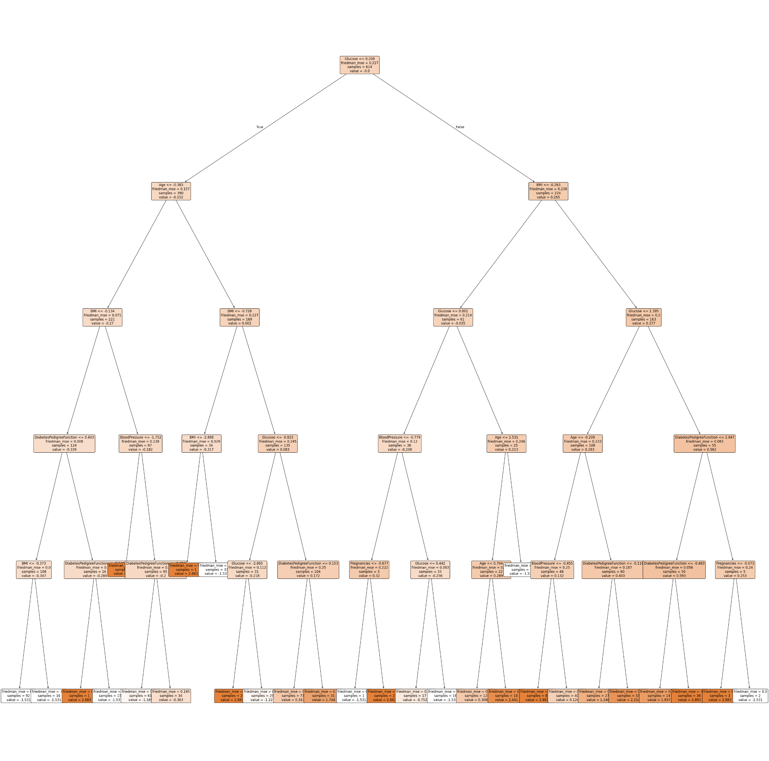
GRADIENT BOOSTING CLASSIFIER ANALYSIS

Slide 25
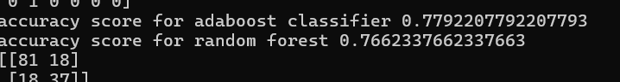
ADA BOOSTING CLASSIFIER

Slide 26
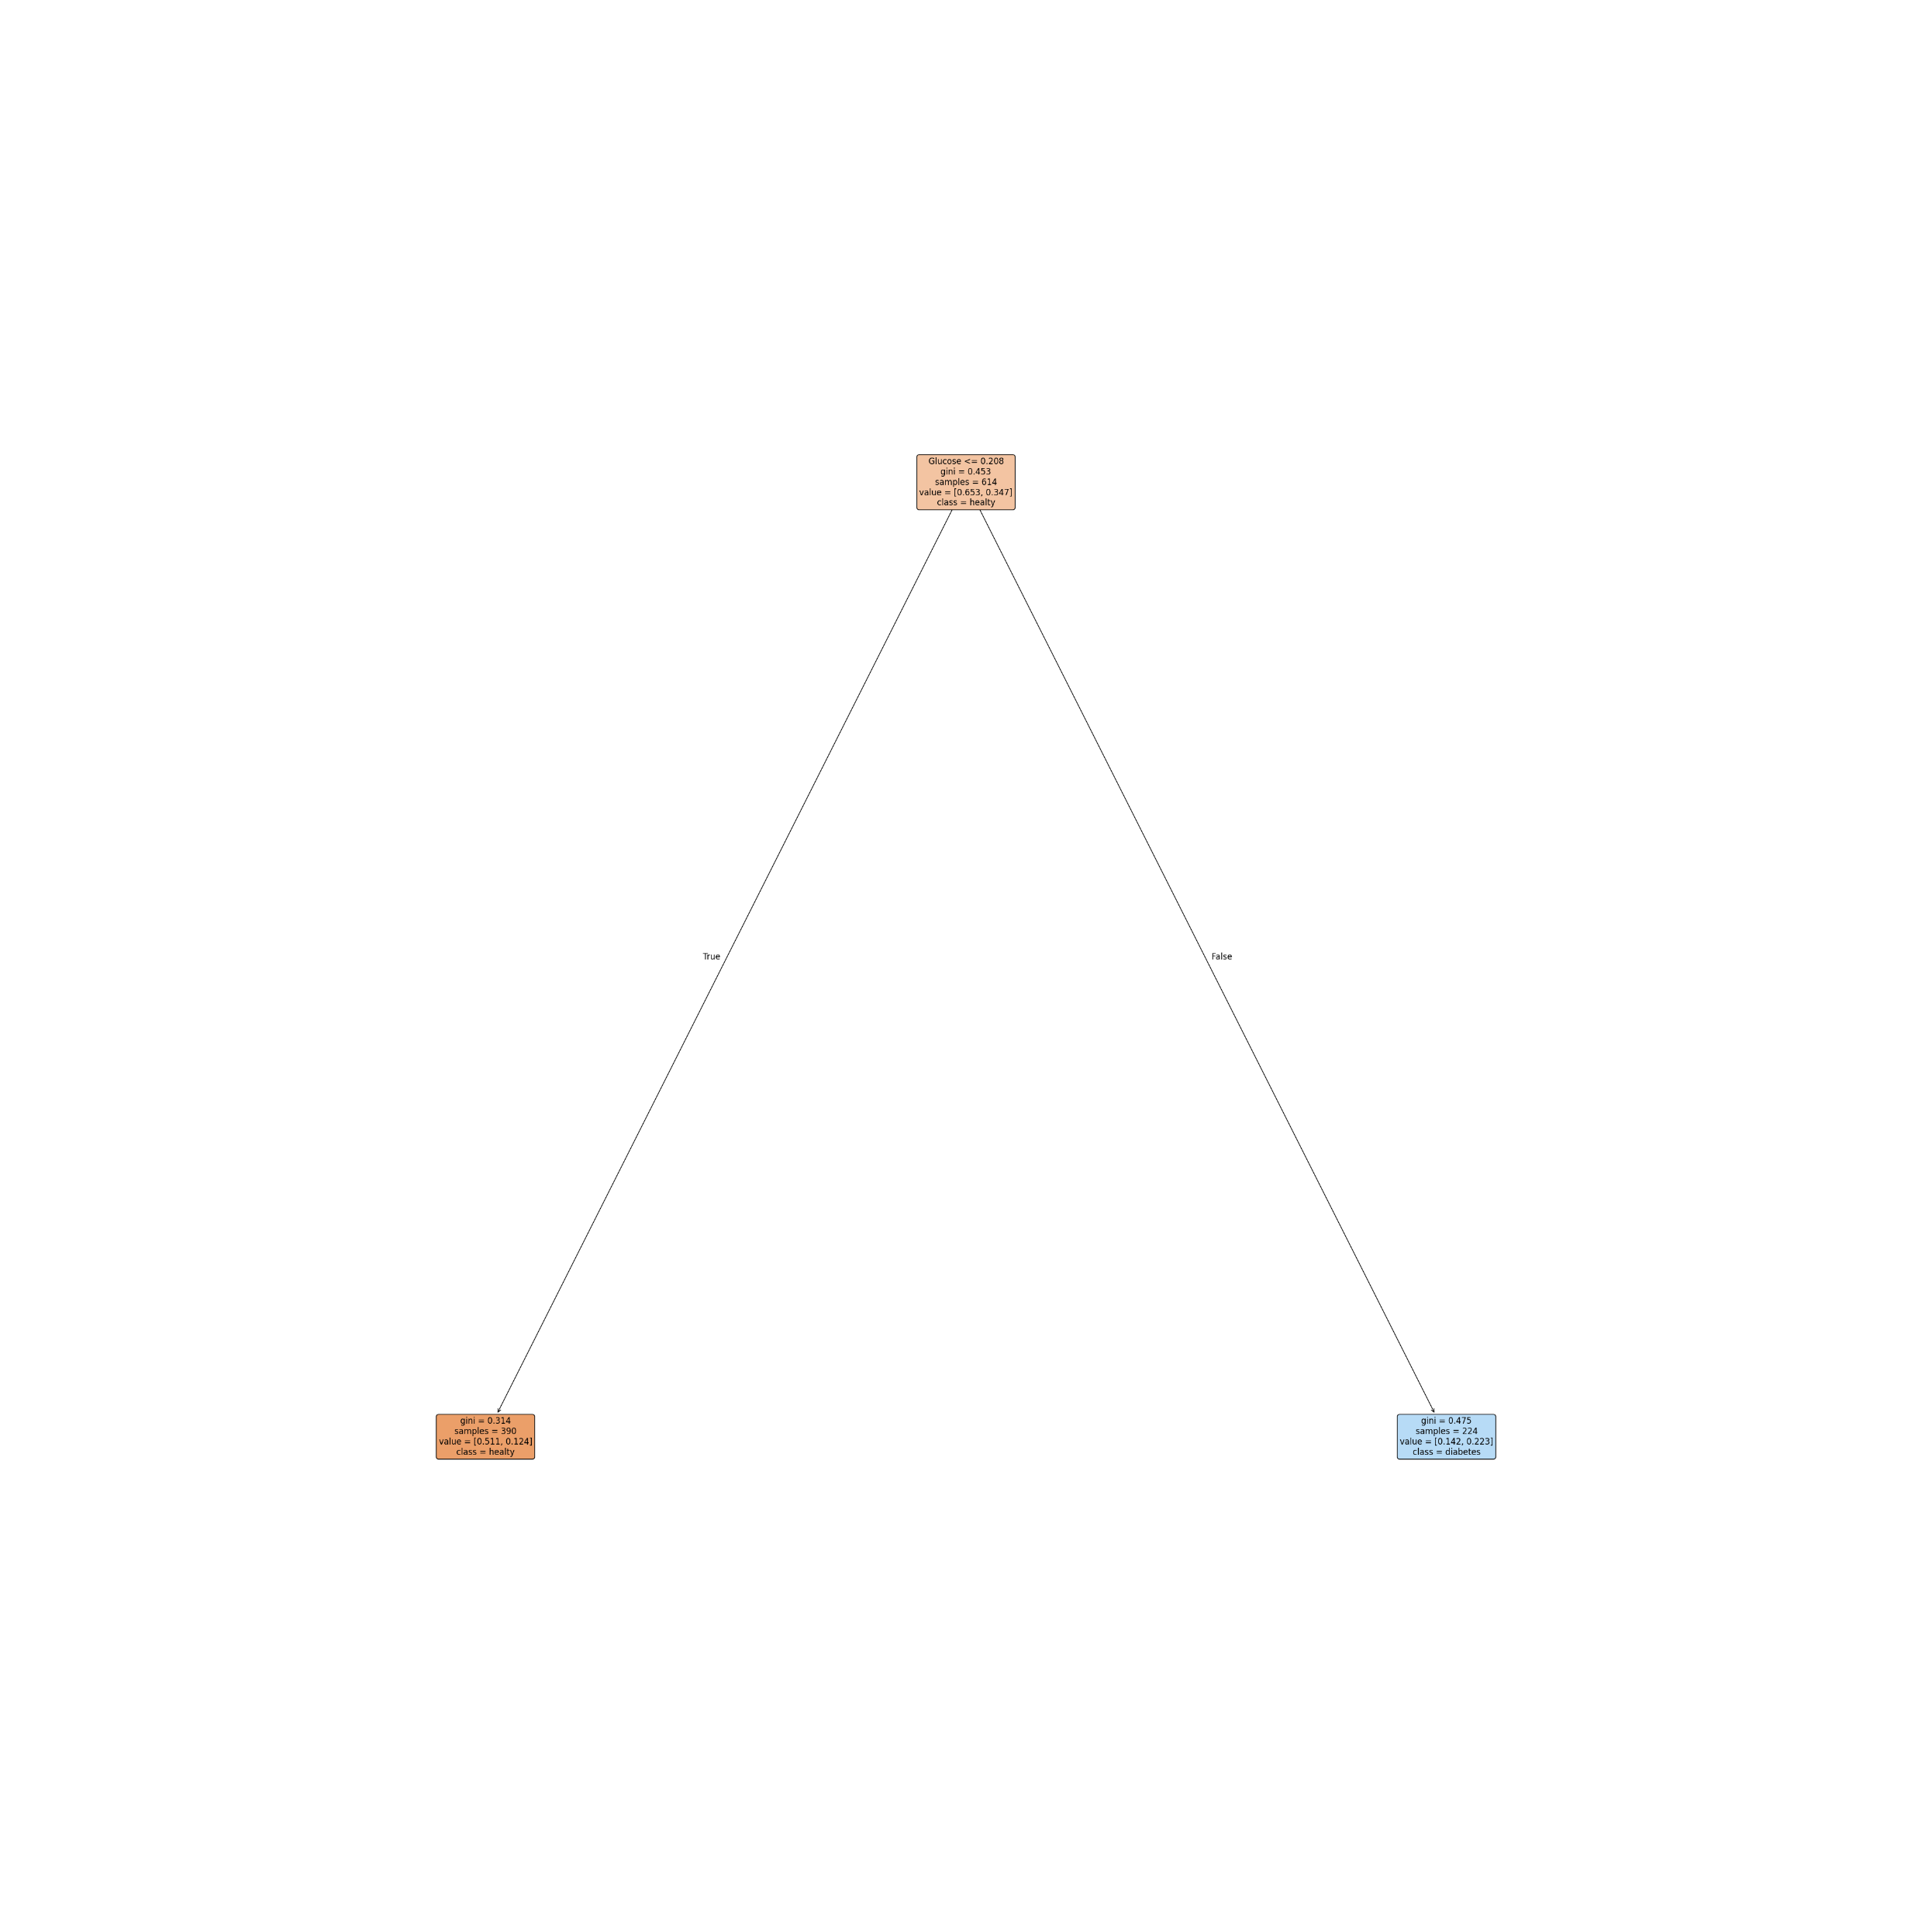
ADA BOOSTING CLASSIFIER ANALYSIS

Slide 27
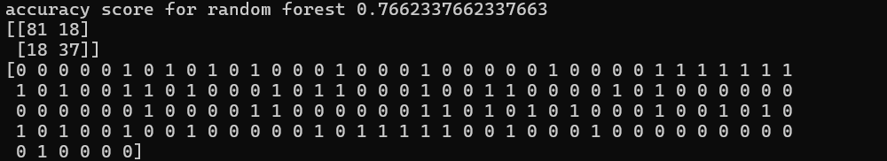
RANDOM FOREST CLASSIFIER

Slide 28
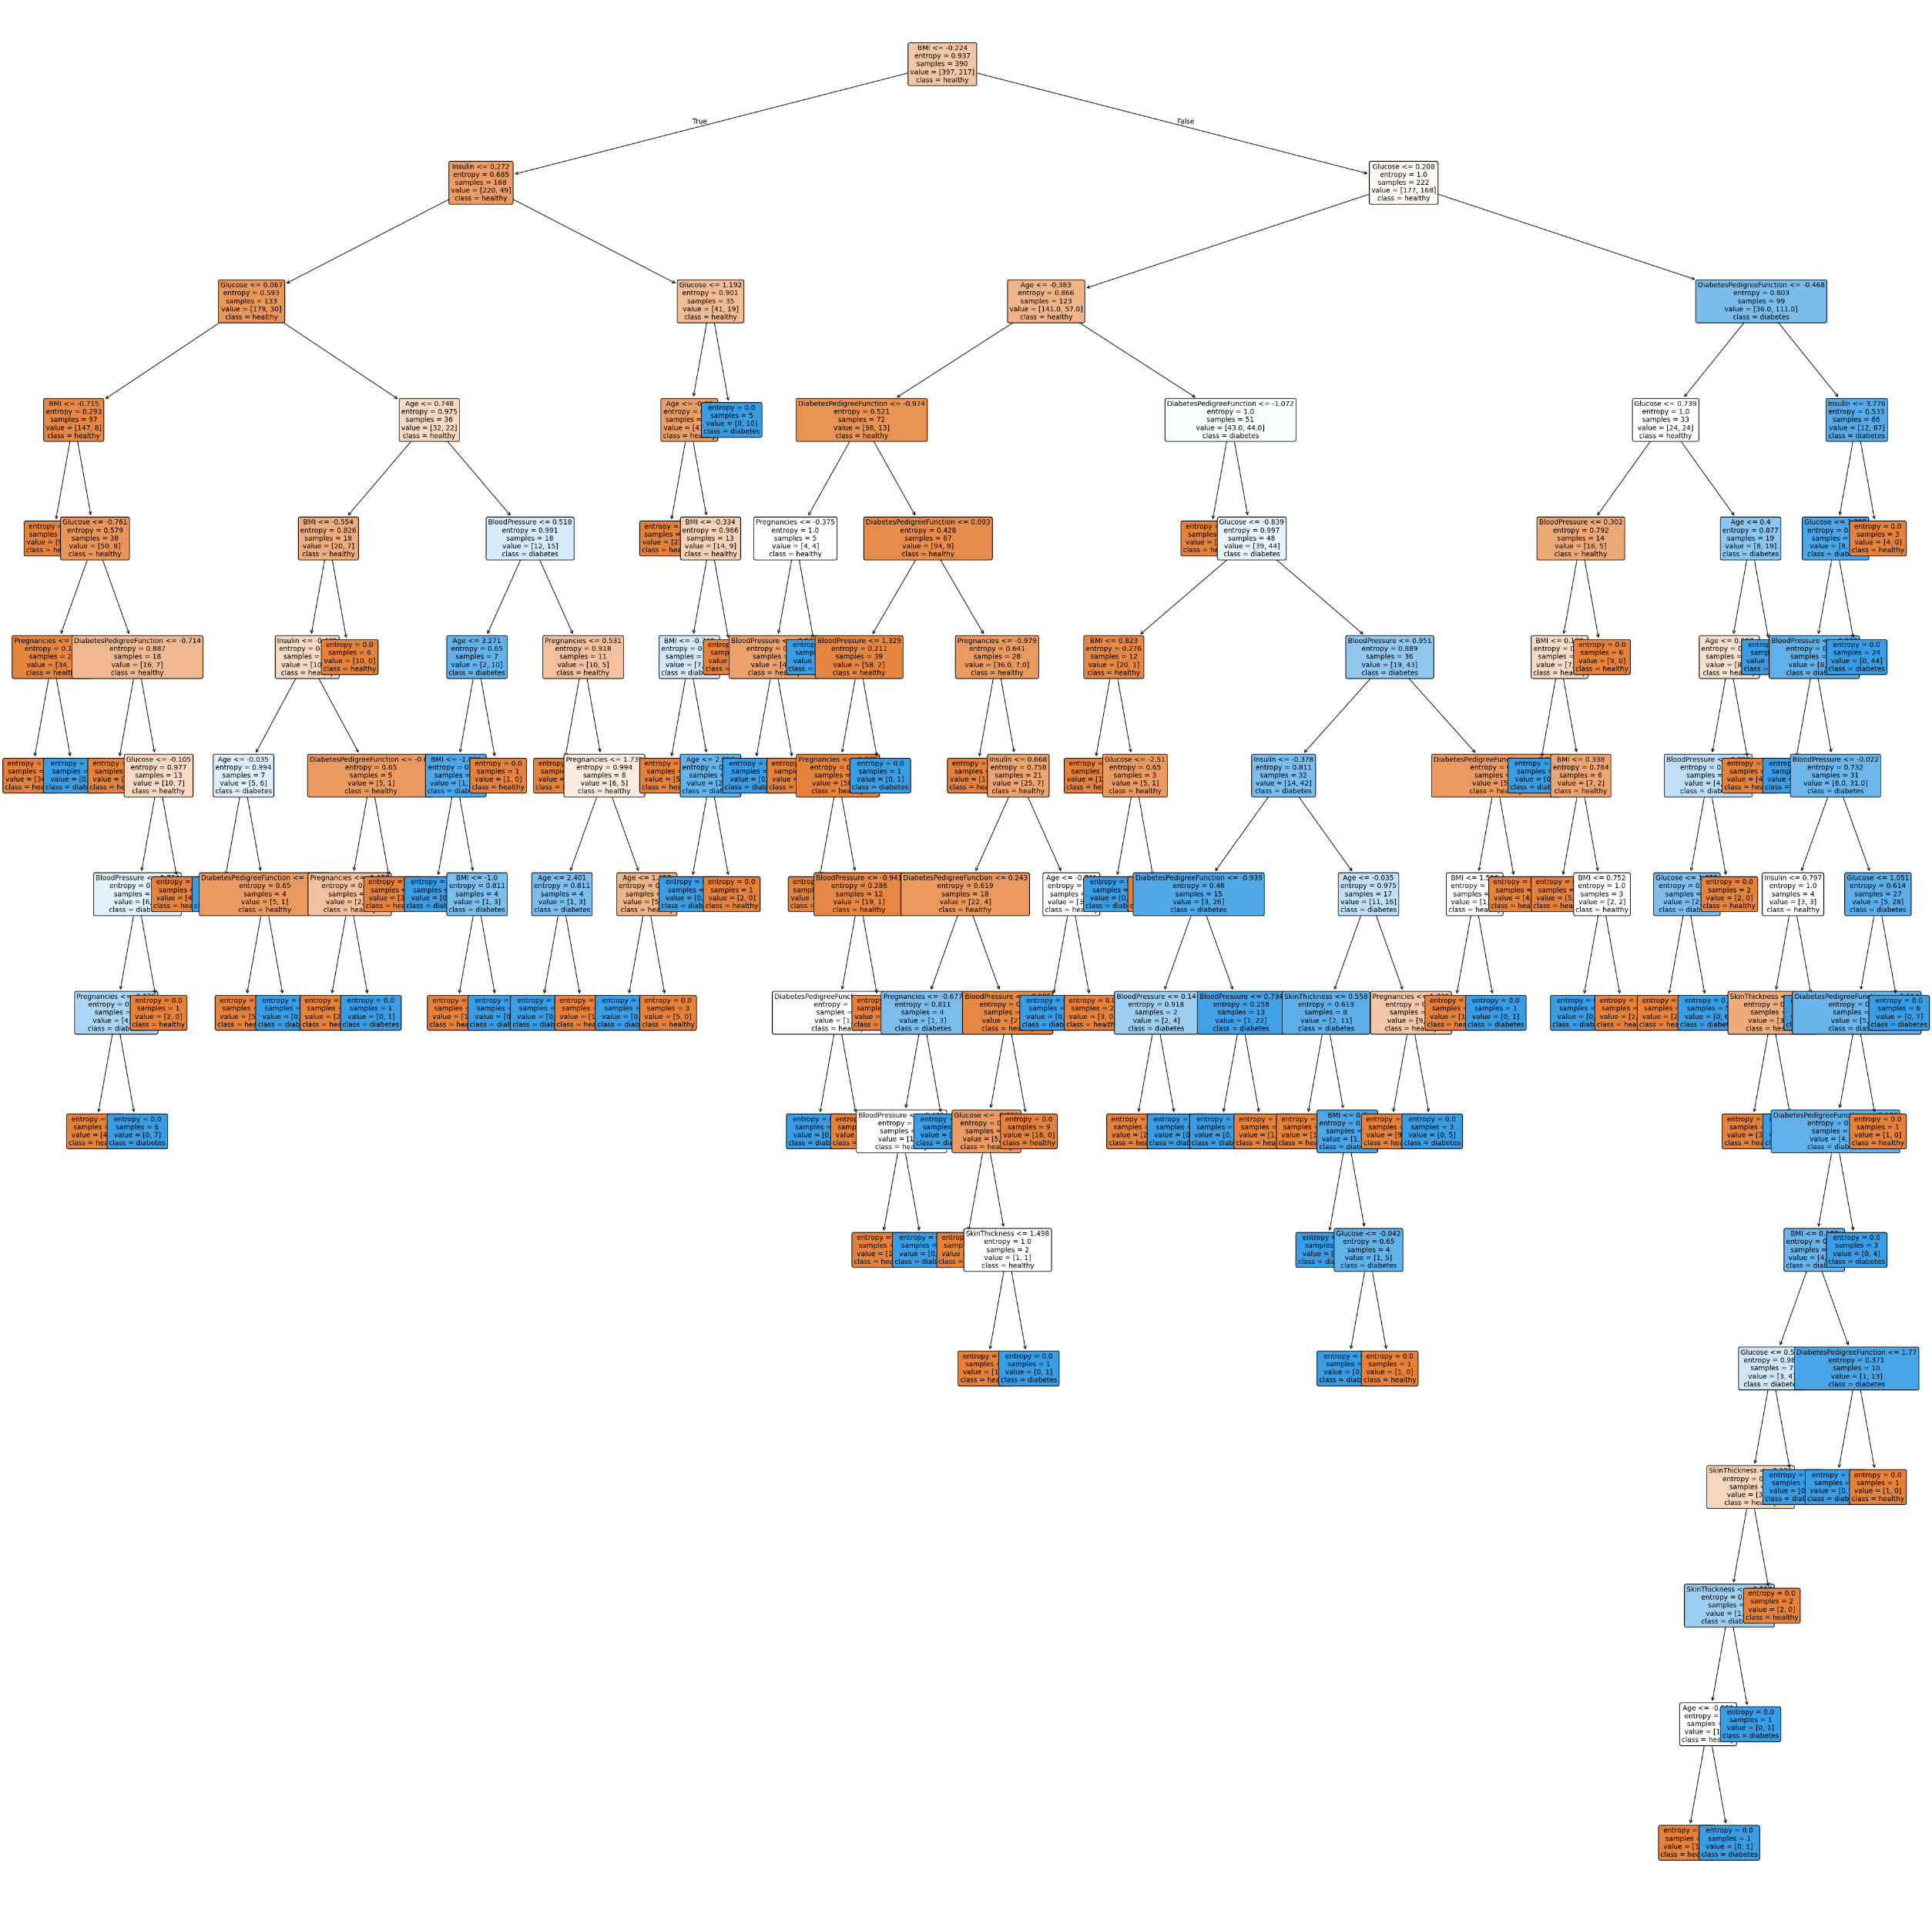
RANDOM FOREST CLASSIFIER ANALYSIS

Slide 29
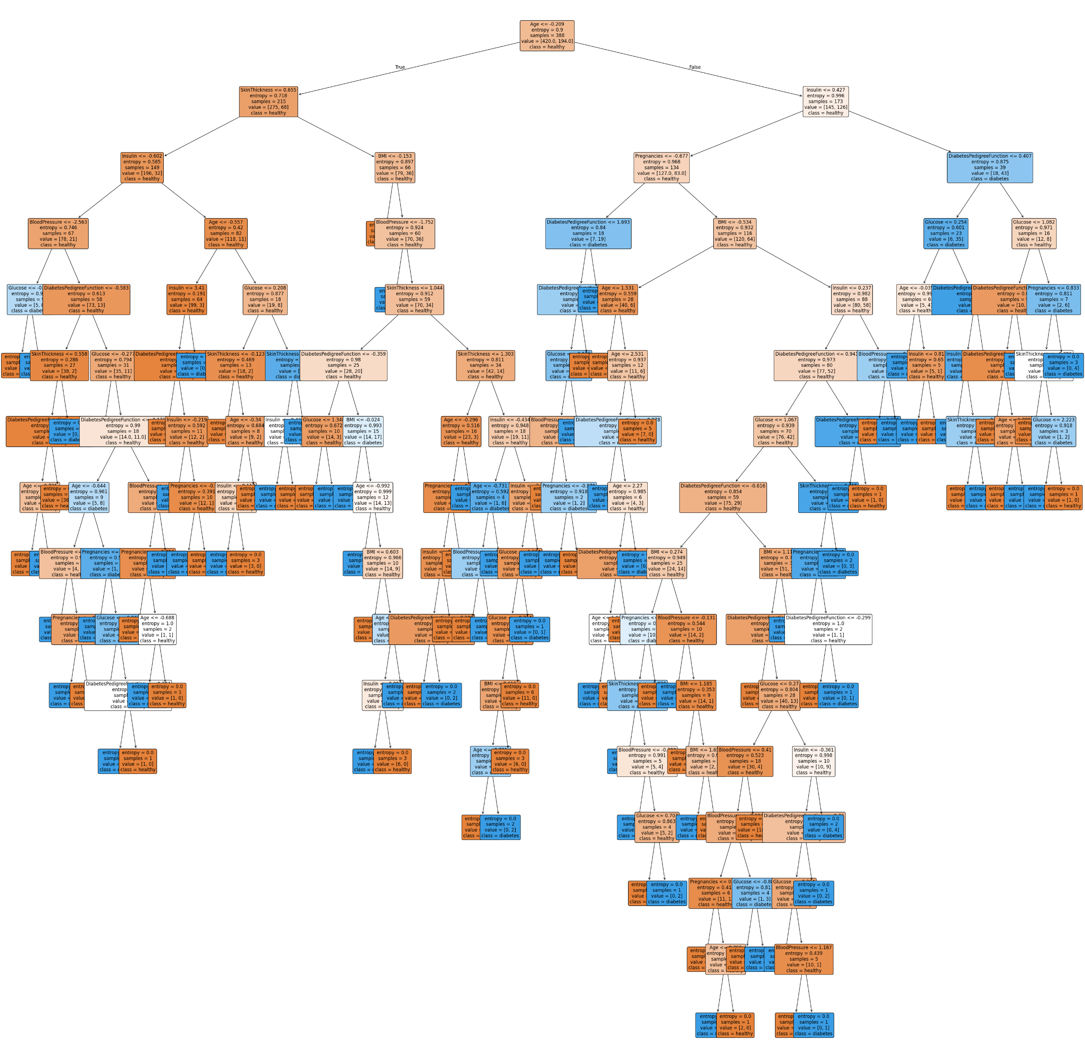
RANDOM FOREST CLASSIFIER ANALYSIS

Slide 30
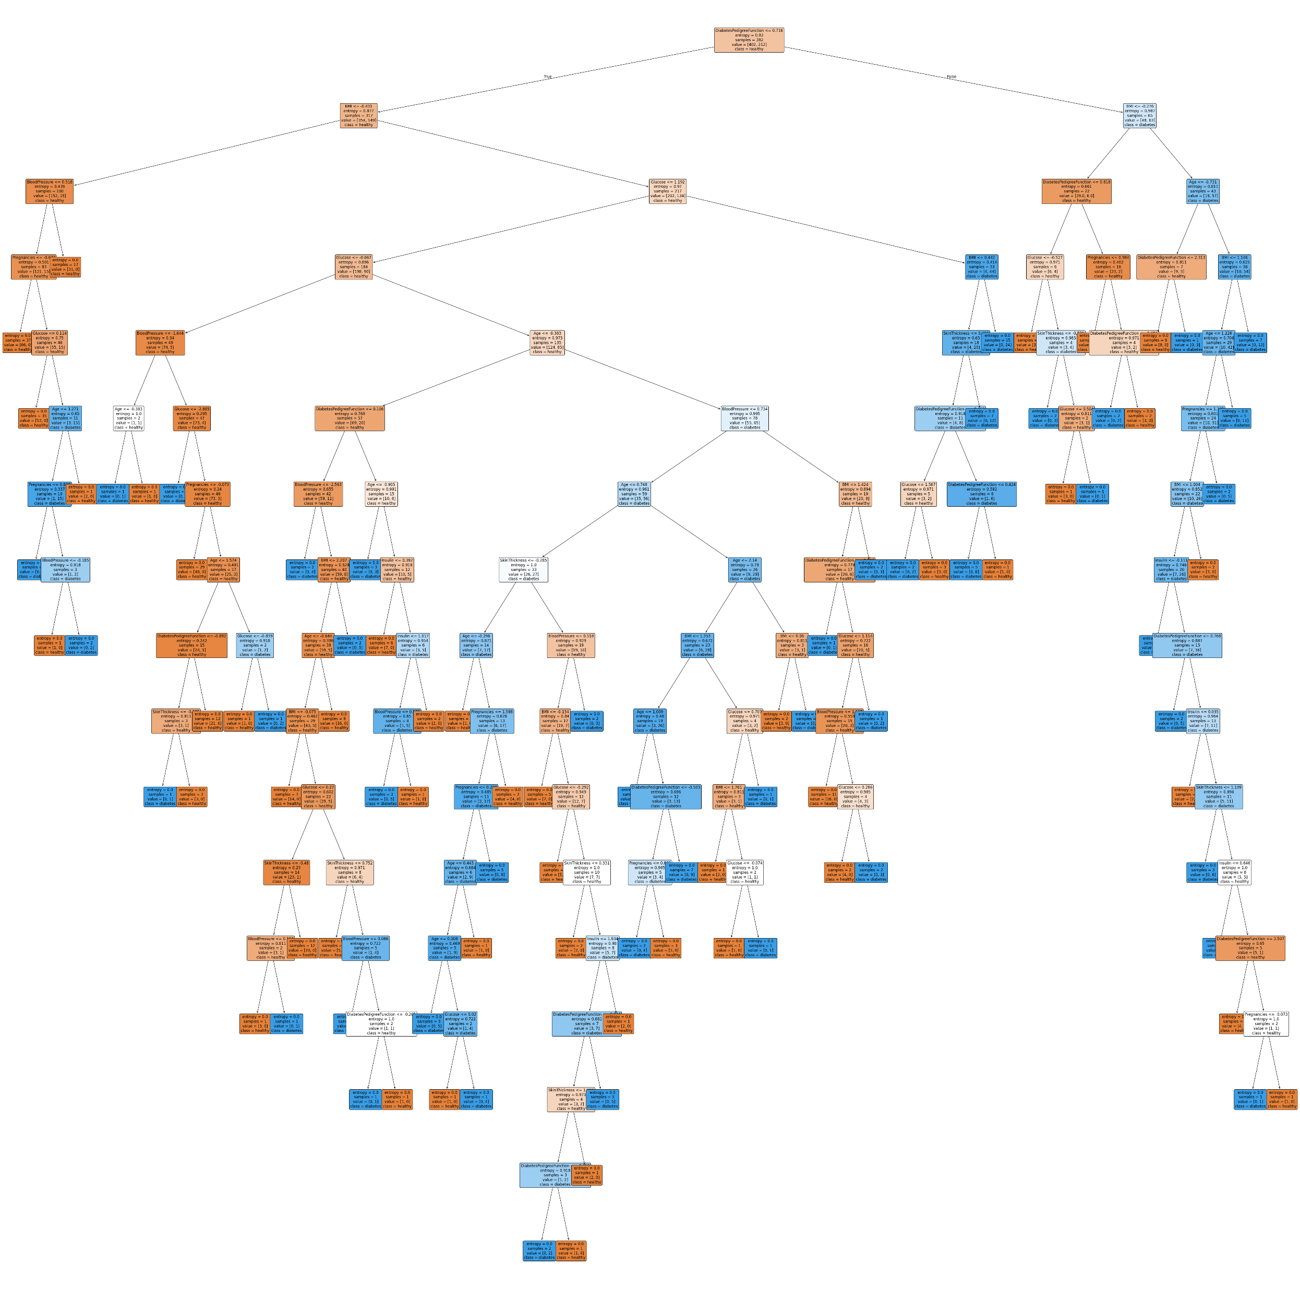
RANDOM FOREST CLASSIFIER ANALYSIS

Slide 31
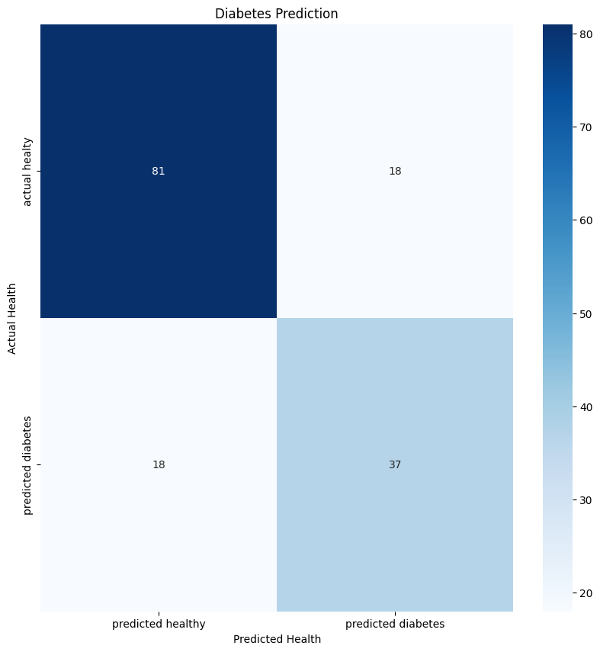
RANDOM FOREST CLASSIFIER CONFUSION MATRIX

Slide 32
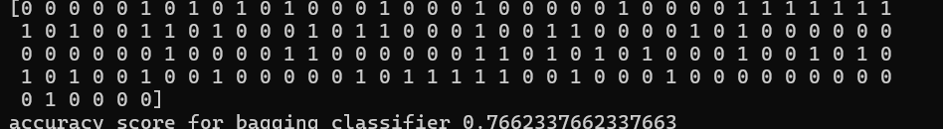
BAGGING CLASSIFIER

Slide 33
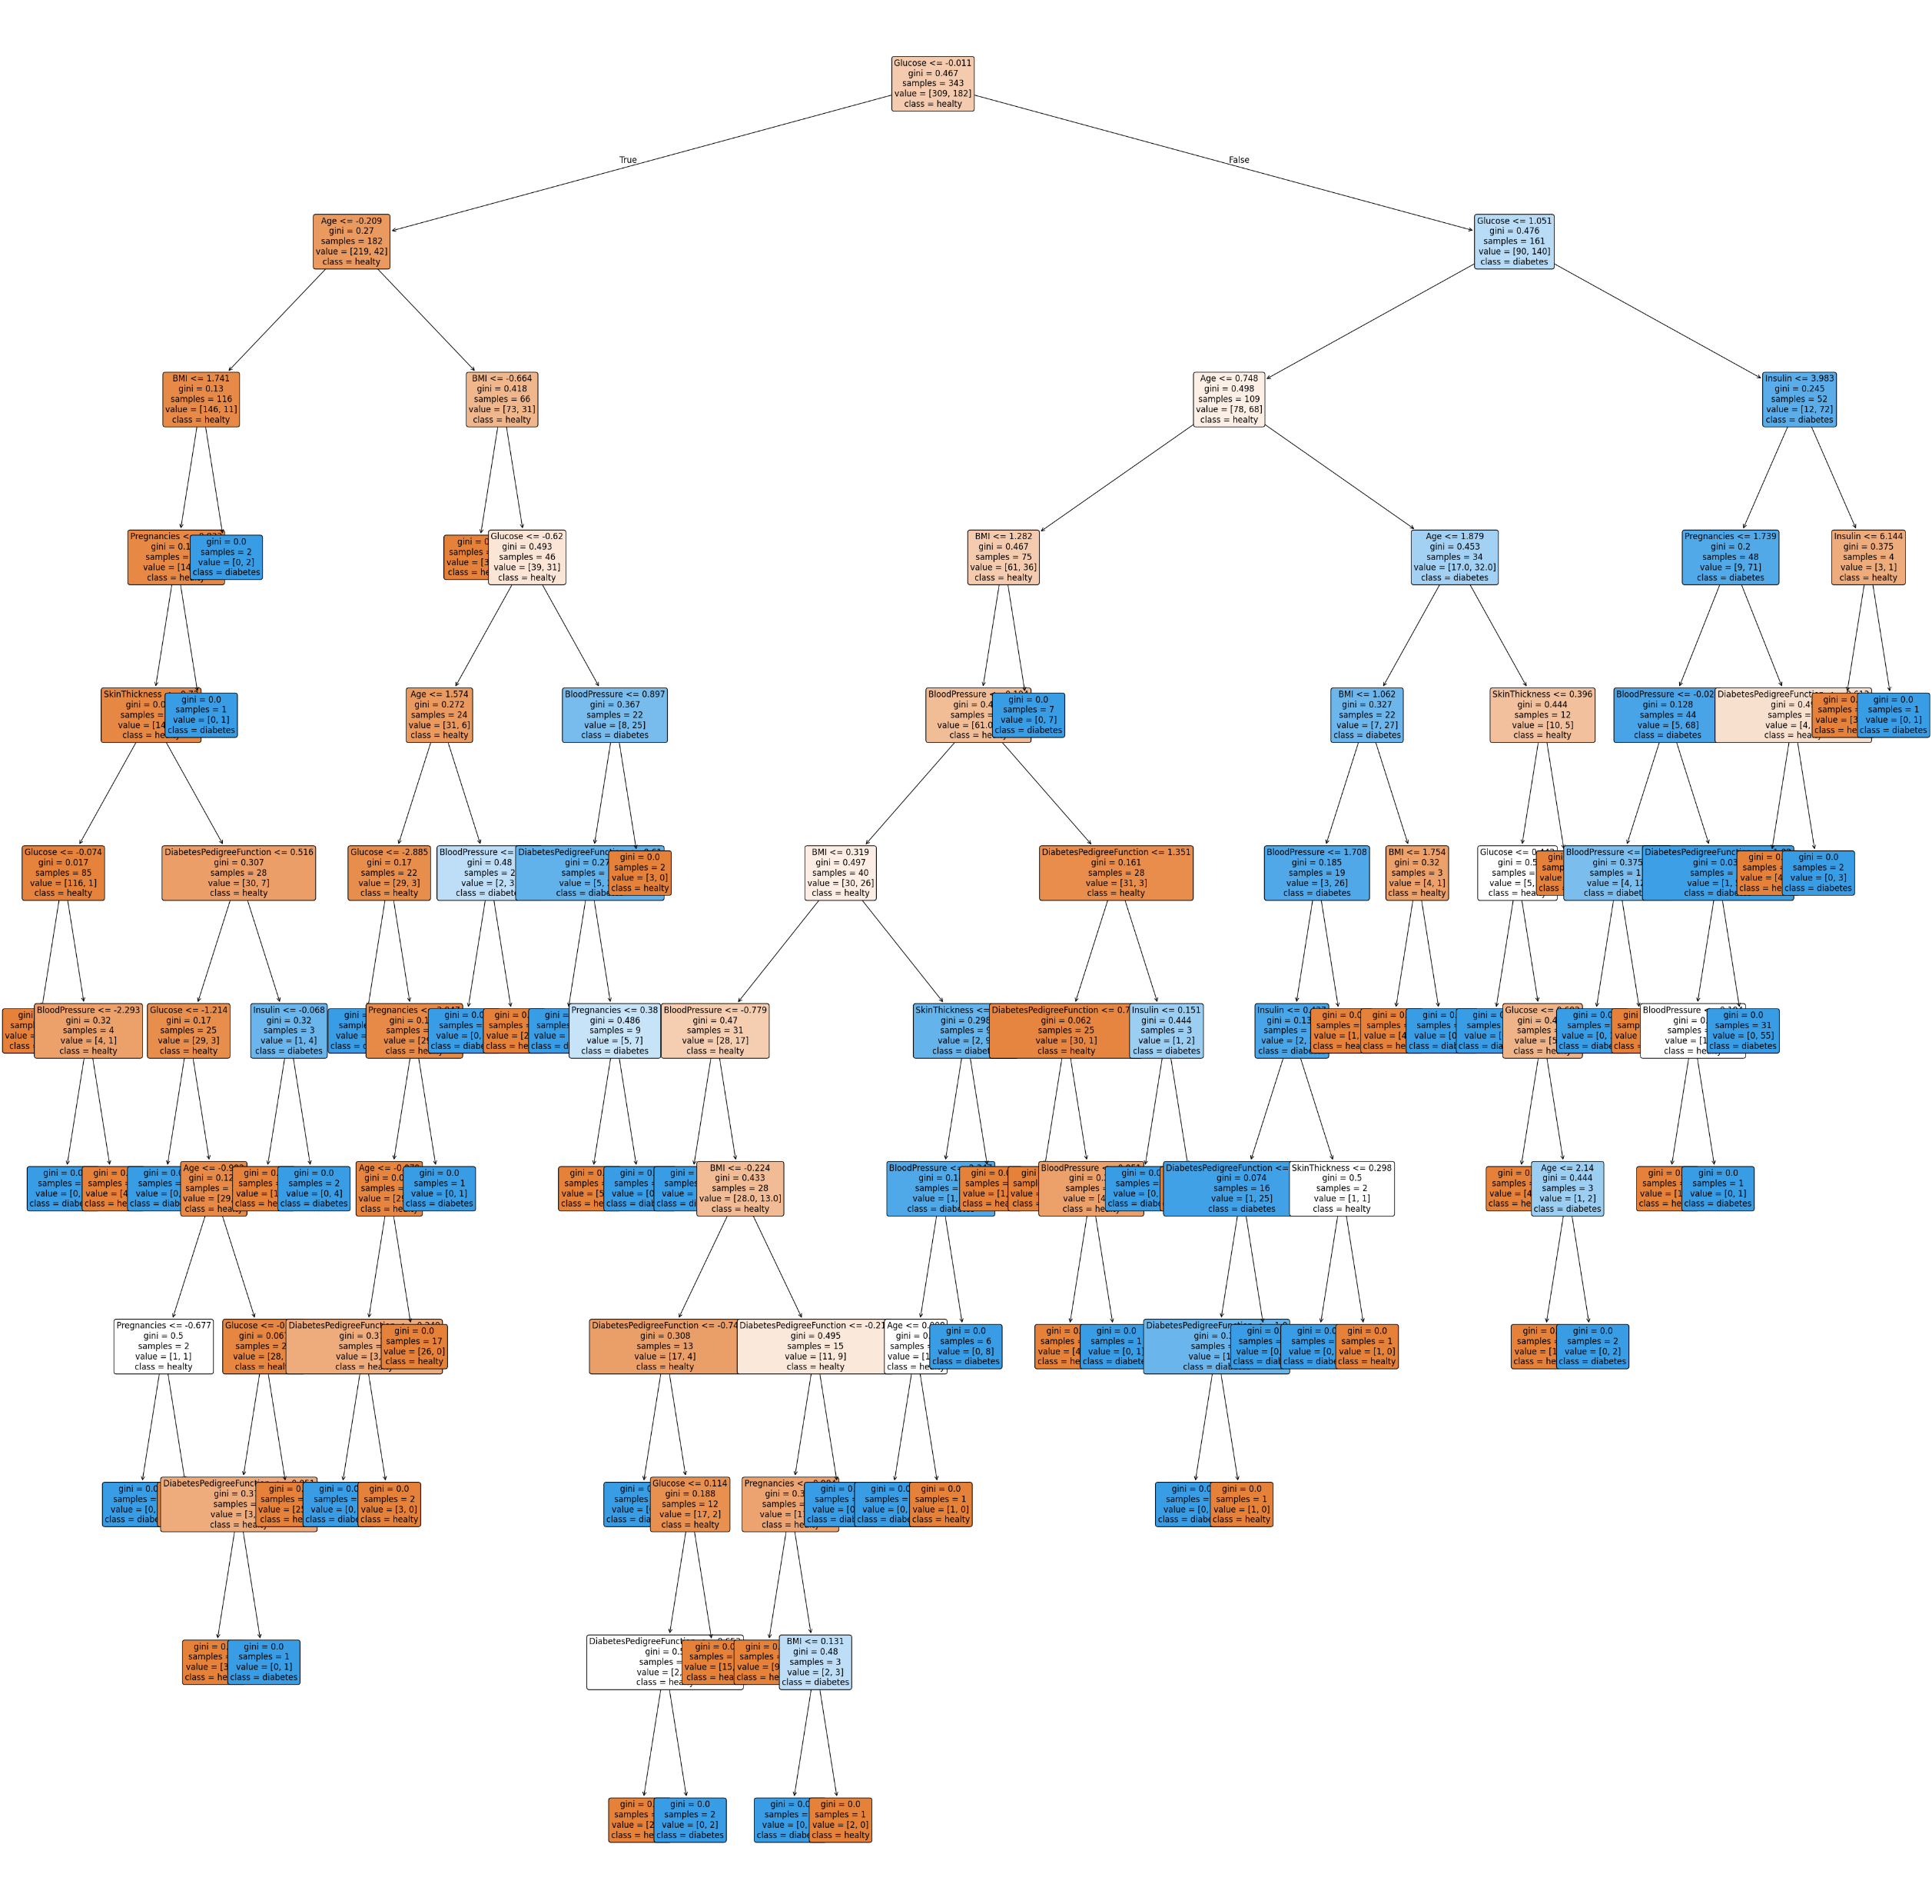
BAGGING CLASSIFIER ANALYSIS

Slide 34
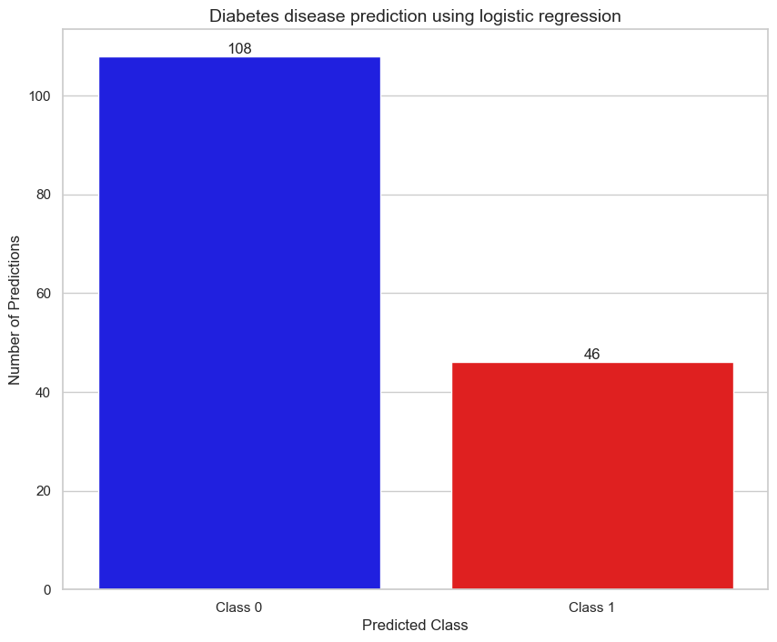
LOGISTIC REGRESSION ANALYSIS

Slide 35
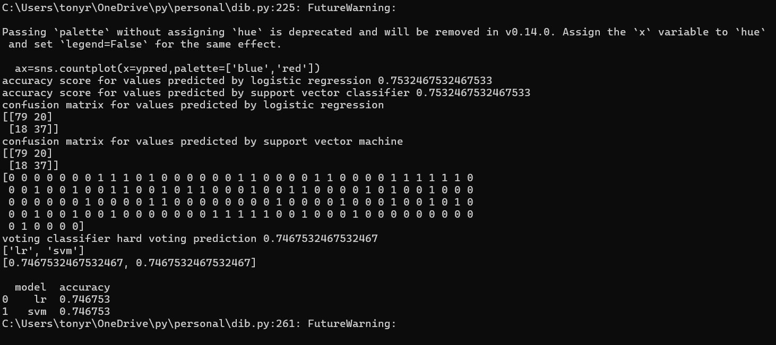
VOTING CLASSIFIER(HARD VOTING)

Slide 36

VOTING CLASSIFIER ANALYSIS(HARD VOTING)

Slide 37
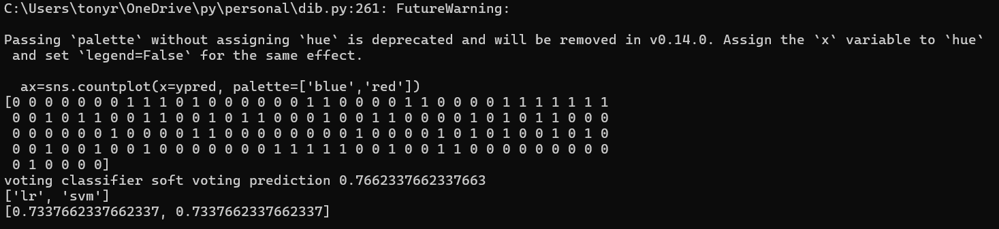
VOTING CLASSIFIER(SOFT VOTING)

Slide 38
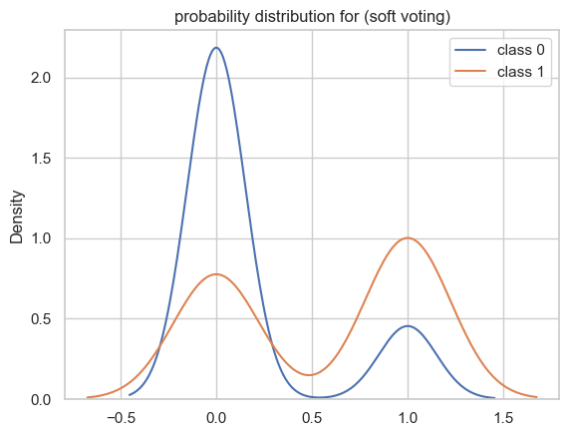
VOTING CLASSIFIER ANALYSIS(SOFT VOTING)

Slide 39
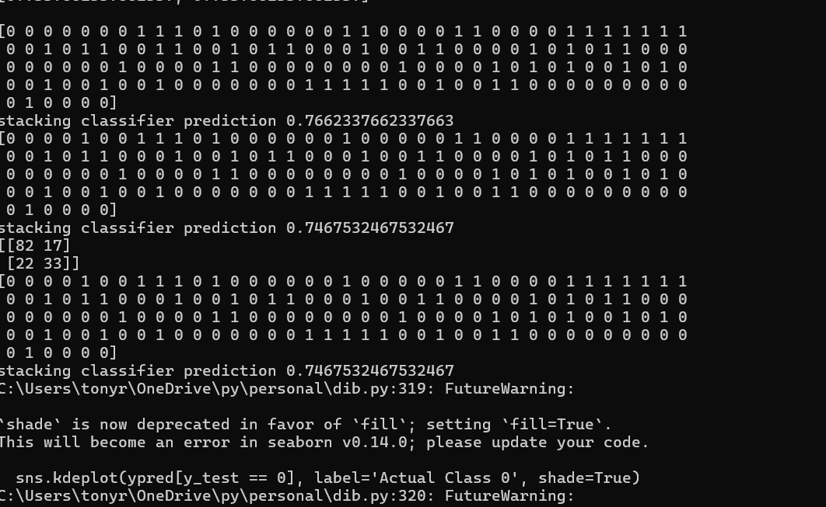
STACKING CLASSIFER

Slide 40
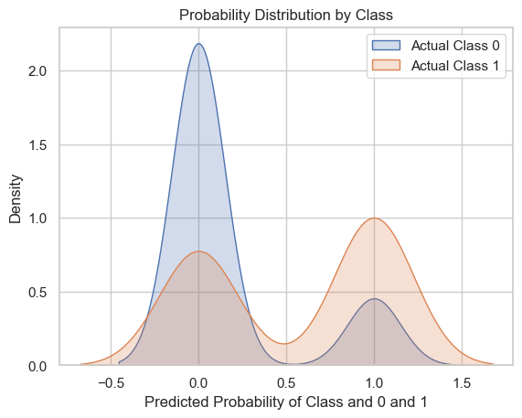
STACKING CLASSIFIER ANALYSIS(META-MODEL)

Slide 41
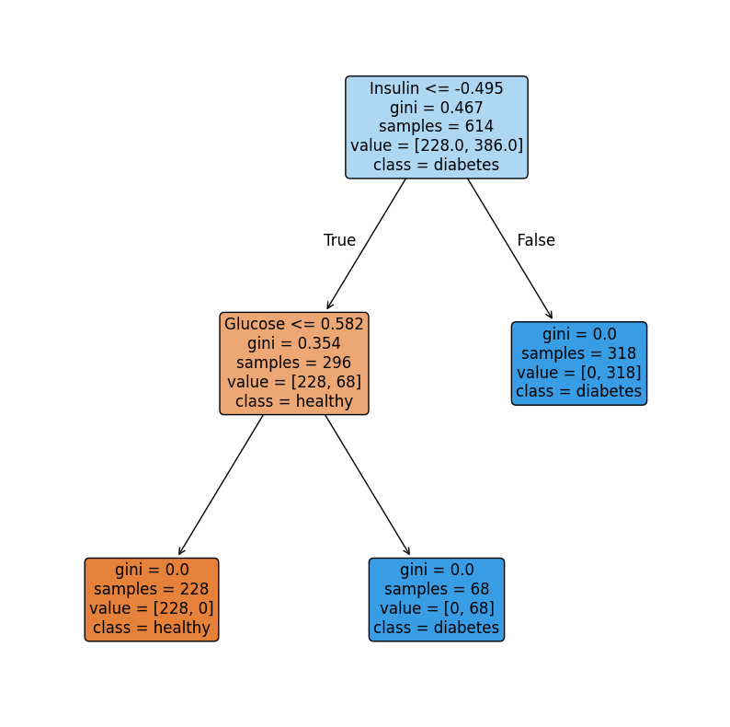
PCA N FEATURE ANALYSIS

Slide 42
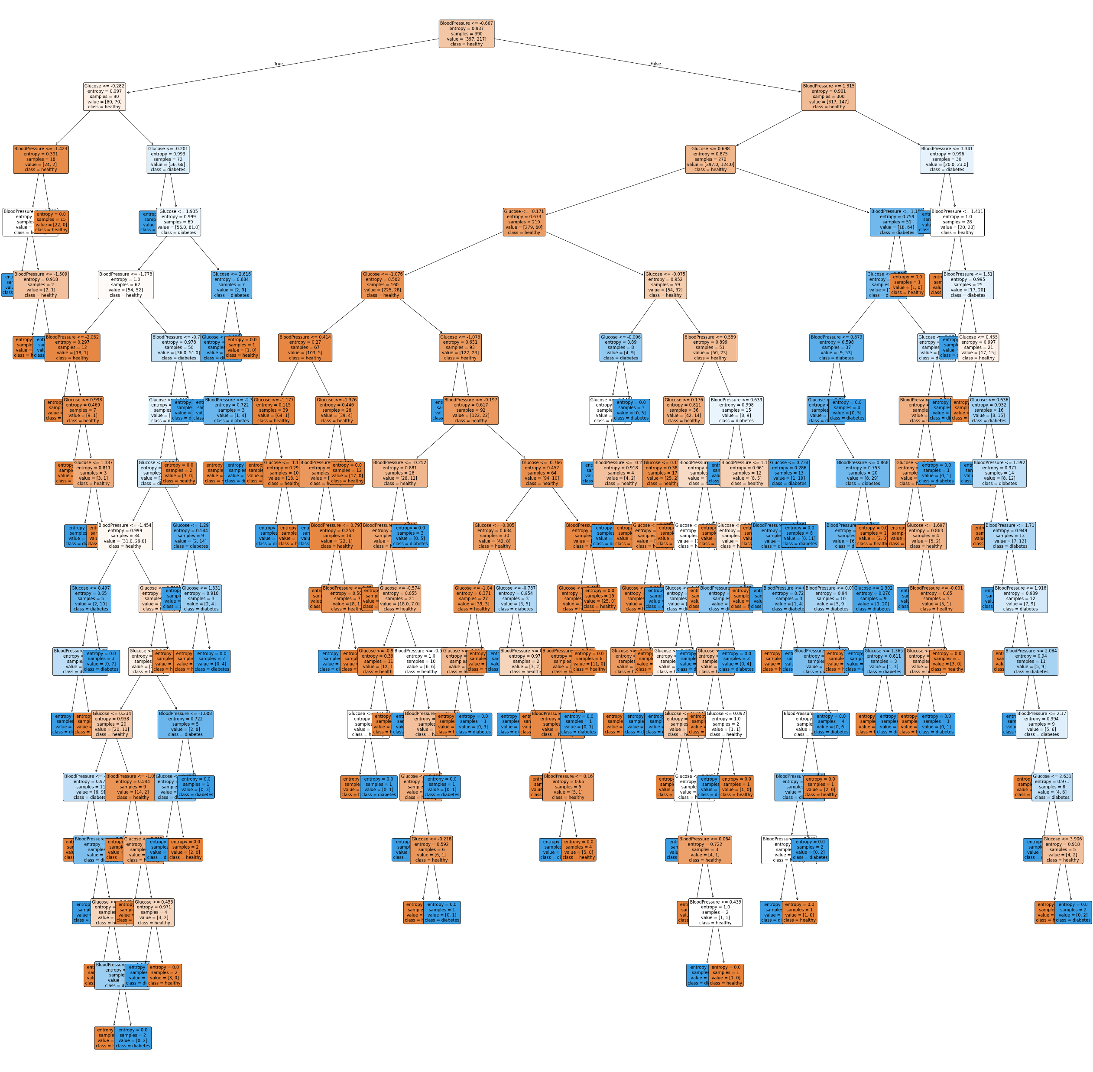
PCA FEATURE ANALYSIS

Slide 43
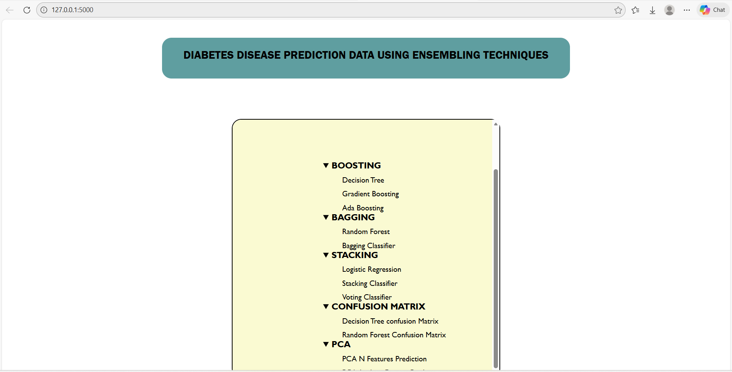
WEB APPLICATION TO VISUALIZE PREDICTED DATA

Slide 44
CONCLUSION
In conclusion, the application of ensemble machine learning techniques for diabetes prediction demonstrates a significant improvement in diagnostic accuracy and reliability compared to individual base models.
By strategically combining the predictive strengths of diverse algorithms—such as Random Forests,
Gradient Boosting, or Stacking—ensemble methods effectively mitigate the risks of overfitting and reduce variance, which are critical challenges in processing complex clinical datasets.
The superior performance of these models in identifying subtle patterns within physiological indicators suggests that ensemble-driven frameworks can serve as robust decision-support tools for healthcare professionals, enabling earlier intervention and more personalized patient management strategies in the fight against chronic disease.

